Slide 1
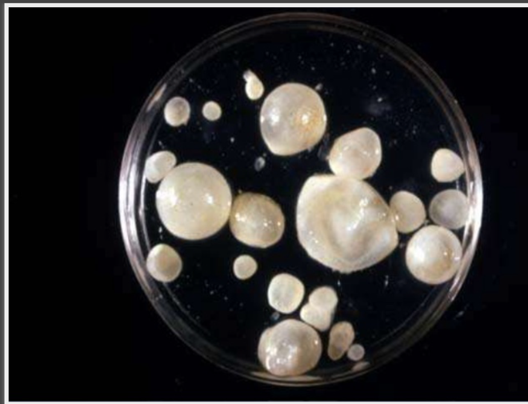
Lecture Title: HYDATID CYST
University of Basrah Al-zahraa college of medicine
Ministry of higher Education and Scientific Research
Block: Gastro-Intestinal Tract (GIT)
Induction phase
Lecture Duration: 1hr
Prof.Dr. Mazin H A l -Hawwaz
This Lecture was prepared by block Staff: block Staff:
Dr. Wisam Hamza Dr. Haider Mohssen Dr. Thura Kadhim
Dr. Jawad Ramadhan Dr. Talal Hadi Dr. Haithem Hussein
Dr. Sadek Hassen Dr. Mustafa Ghazi Dr. Shuhdi Hussein
Dr. Nawaf Salah Aldeen
This Lecture was loaded in blackboard and you can find the material
Baily and Love’s Short Practice of Surgery, 25th edition, 2008
For more detailed instructions, any question, or you have a case you need help in, please post
to the group of session

Slide 2
University of Basrah Al-zahraa medical college
Ministry of higher Education and Scientific Research
LEARING OBJECTIVES
LO1-To know causative parasite
LO2- How the person get infection
LO3-Clinical presntation
LO4- Methods of diagnosis
LO5- Methods of treatments
LO6- Complications

Slide 3
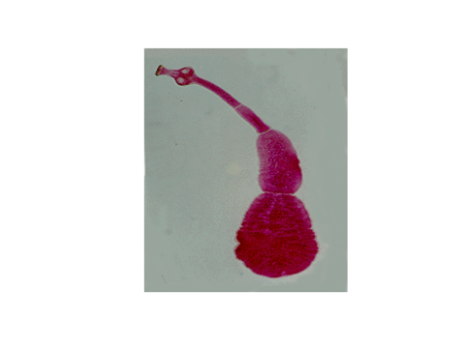
University of Basrah Al-zahraa medical college
Ministry of higher Education and Scientific Research
1.Echinococcus graunulosus
Cystic Echinococcosis
2. Echinococcus Multilocularis
Alveolar Echinococcosis
3.E.Vogeli
polycystic hydatid

Slide 4
University of Basrah Al-zahraa medical college
Ministry of higher Education and Scientific Research

Slide 5
University of Basrah Al-zahraa medical college
Ministry of higher Education and Scientific Research

Slide 6
University of Basrah Al-zahraa medical college
Ministry of higher Education and Scientific Research

Slide 7
University of Basrah Al-zahraa medical college
Ministry of higher Education and Scientific Research

Slide 8
Life cycle
University of Basrah Al-zahraa medical college
Ministry of higher Education and Scientific Research
Definitive host :dog & other canine
Intermediate host : sheep ,cattle , camel
Human – accidental host
Infective stage: egg( gravid proglottid)
MAN IS DEAD END HOST

Slide 9
University of Basrah Al-zahraa medical college
Ministry of higher Education and Scientific Research

Slide 10
University of Basrah Al-zahraa medical college
Ministry of higher Education and Scientific Research

Slide 11
Layers of Hydatid Cyst
University of Basrah Al-zahraa medical college
Ministry of higher Education and Scientific Research
The hydatid has three layers :
The outer peri cyst , composed of modified host cells that form a dense and fibrous protective zone .
The middle laminated membrane ,which is acellular and allows the passage of nutrients.
The inner germinal layer, where the scolices (the larval stage of the parasite ) and the laminated membrane are produced

Slide 12
Incidence
University of Basrah Al-zahraa medical college
Ministry of higher Education and Scientific Research
Hydatid liver disease affects all age groups, both sexes equally ,and no predisposing pathologic conditions are associated with infection
Washing hands after contact with canines , eliminating the consumption of vegetables grown at ground level from the diet ,and stopping the practice of feeding entrails of slaughtered animals to dogs have all aided in decreasing the incidence of the disease

Slide 13
Clinical manifestation
University of Basrah Al-zahraa medical college
Ministry of higher Education and Scientific Research
Depend on
1- site
2-size
3-whether the cyst is alive or not
4- whether the cyst is infected or not

Slide 14
Organs affected by E granulosus are
University of Basrah Al-zahraa medical college
Ministry of higher Education and Scientific Research
The liver (63%)
Lungs (25%)
Muscles (5%)
Bones (3%)
Kidneys (2%)
Brain (1%)
Spleen (1%)

Slide 15
University of Basrah Al-zahraa medical college
Ministry of higher Education and Scientific Research

Slide 16
University of Basrah Al-zahraa medical college
Ministry of higher Education and Scientific Research

Slide 17
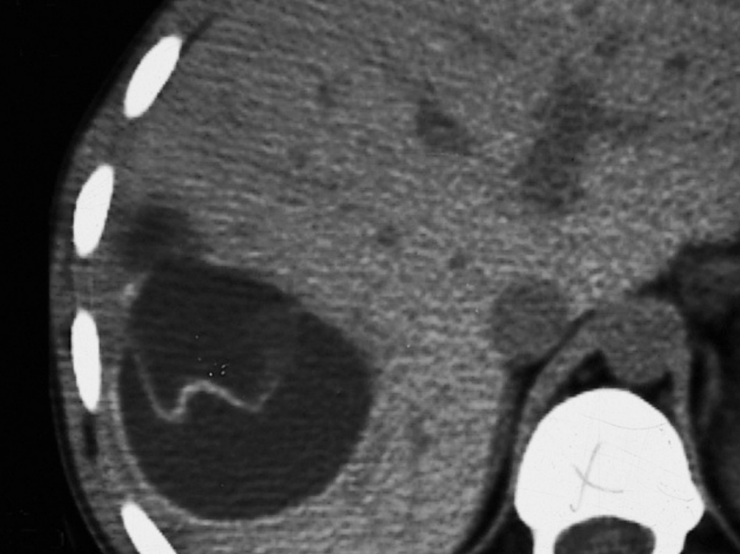
University of Basrah Al-zahraa medical college
Ministry of higher Education and Scientific Research

Slide 18
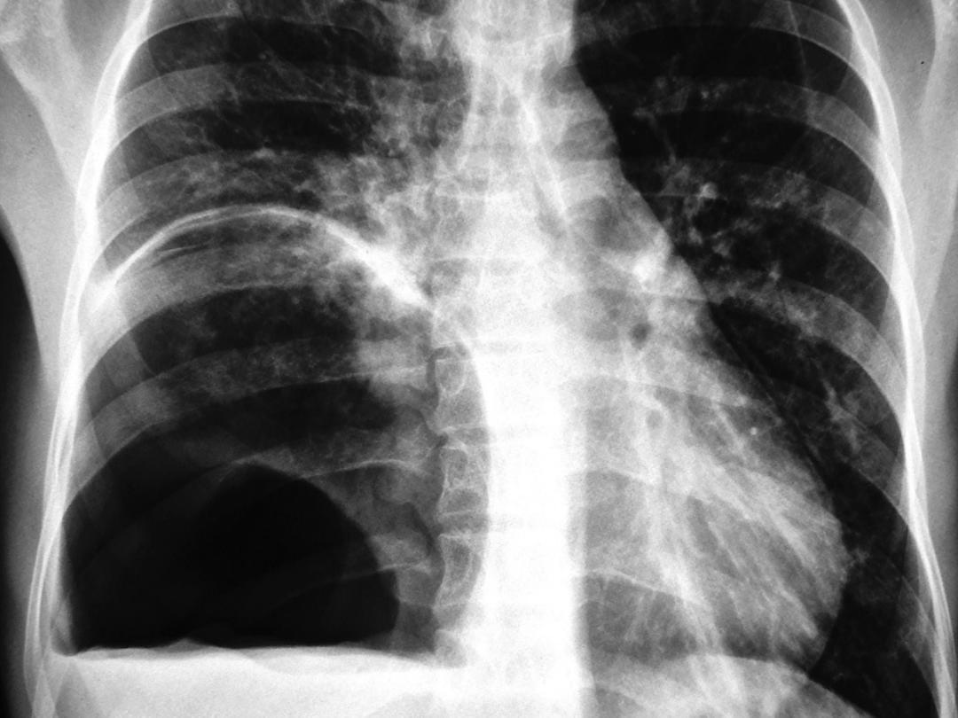
University of Basrah Al-zahraa medical college
Ministry of higher Education and Scientific Research

Slide 19
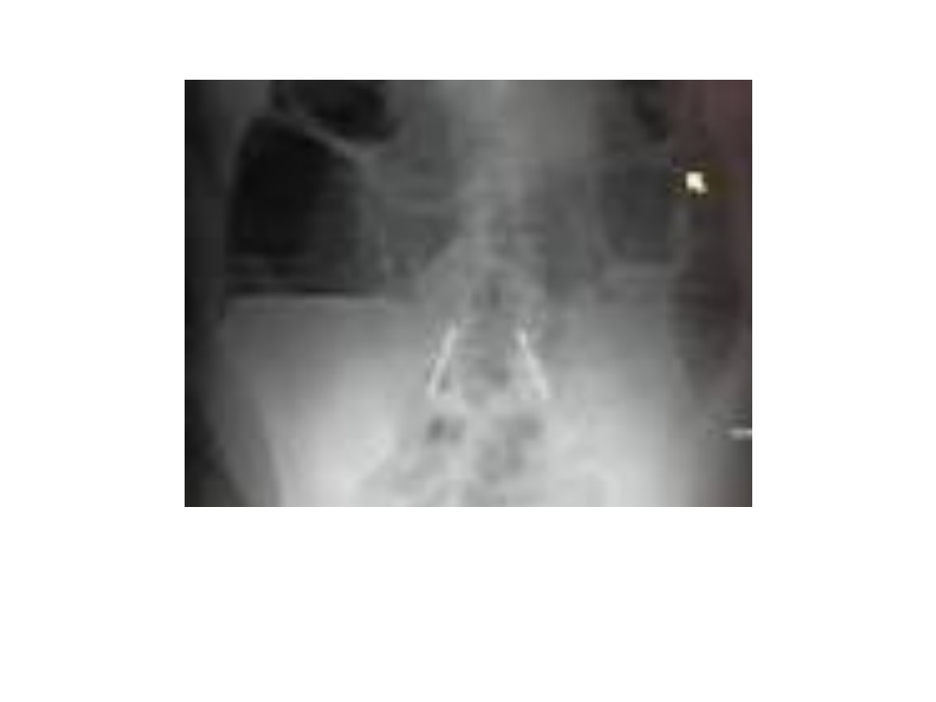
University of Basrah Al-zahraa medical college
Ministry of higher Education and Scientific Research

Slide 20
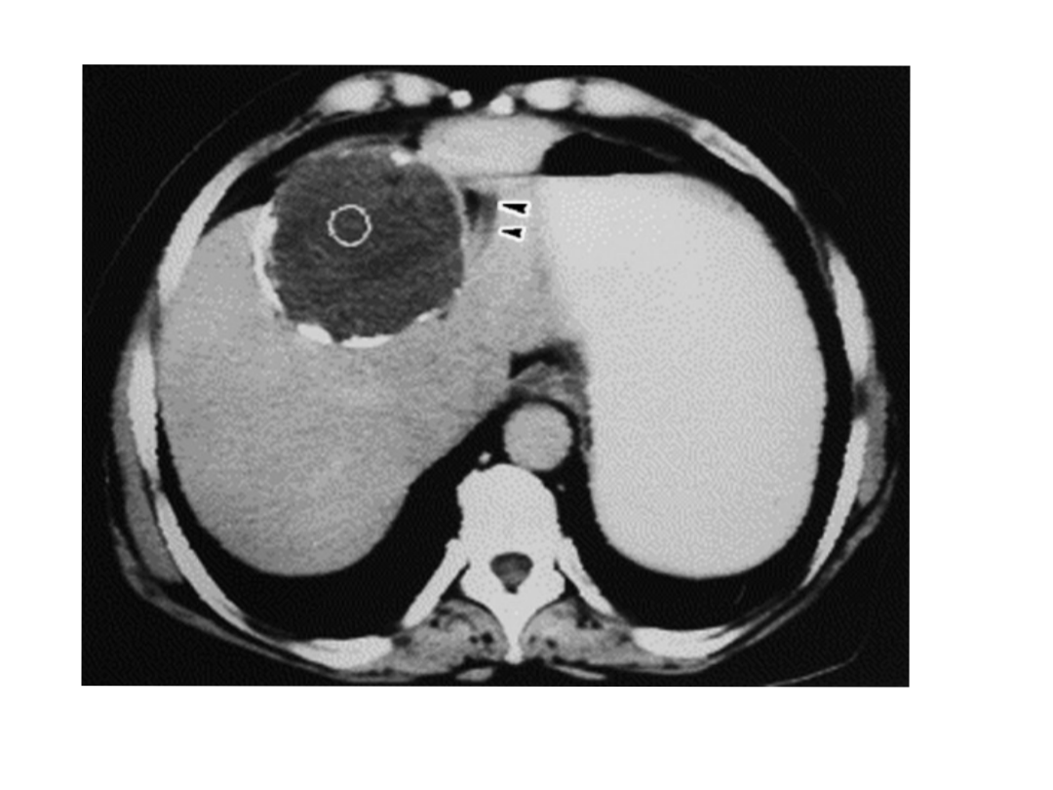
University of Basrah Al-zahraa medical college
Ministry of higher Education and Scientific Research

Slide 21
University of Basrah Al-zahraa medical college
Ministry of higher Education and Scientific Research

Slide 22
Investigations
University of Basrah Al-zahraa medical college
Ministry of higher Education and Scientific Research
Routine blood investigations are nonspecific -25% eosinophilia
Raised bilirubin
ELSIA is useful in follow up to detect recurrence
Cassoni intradermal test

Slide 23
University of Basrah Al-zahraa medical college
Ministry of higher Education and Scientific Research

Slide 24
University of Basrah Al-zahraa medical college
Ministry of higher Education and Scientific Research
Treatment
Medical
Surgical
Pair ( percutaneous aspiration , injection ,aspiration )
Endoscopic

Slide 25
Medical treatment
University of Basrah Al-zahraa medical college
Ministry of higher Education and Scientific Research
Indications
1- Small cysts
2-Un operable cyst because of location or medical diseases
3- peritoneal cyst
4- Multiple cysts
5- Unfit patient to surgery due to medical diseases
Contraindications
1-early pregnancy
2- chronic hepatic disease
3- large cyst with risk of rupture
4- calcified cyst

Slide 26
University of Basrah Al-zahraa medical college
Ministry of higher Education and Scientific Research
Medical T/T
Mebendazole (3-6 months orally in dosages of 40-50 mg /kg /d)
albendazole (10-15 mg /kg/d orally 3-6 months with intervals of 14 days )

Slide 27
University of Basrah Al-zahraa medical college
Ministry of higher Education and Scientific Research

Slide 28
University of Basrah Al-zahraa medical college
Ministry of higher Education and Scientific Research

Slide 29
Scolicidal Agents
University of Basrah Al-zahraa medical college
Ministry of higher Education and Scientific Research
1- 95% alcohol
2- Hypertonic saline
3-3% hydrogen peroxide
4- Betadine

Slide 30
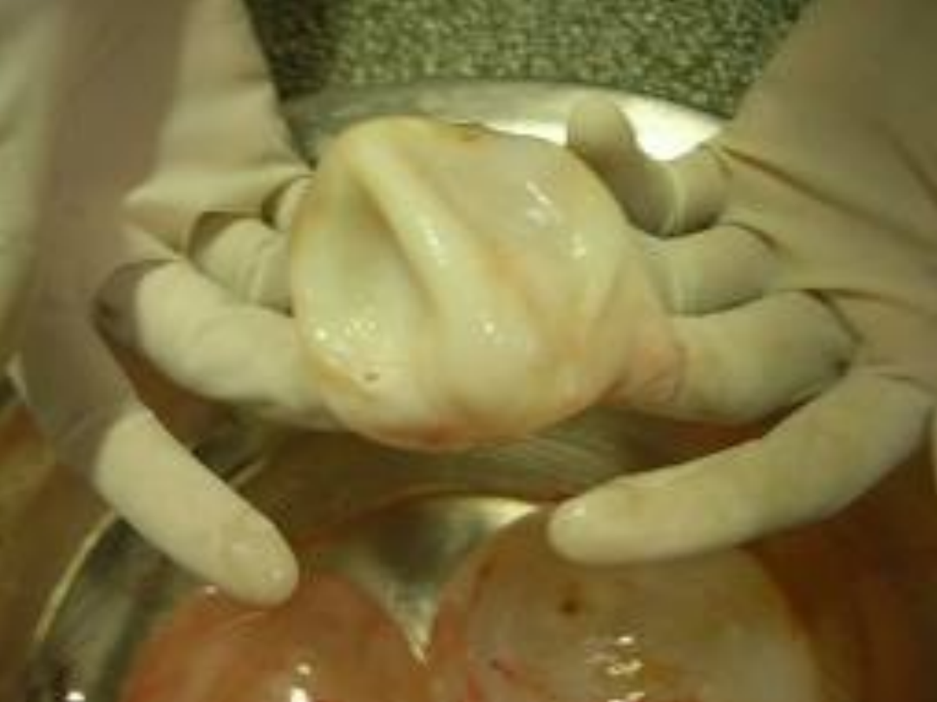
University of Basrah Al-zahraa medical college
Ministry of higher Education and Scientific Research
THANK YOU

Slide 31
University of Basrah Al-zahraa medical college
Ministry of higher Education and Scientific Research

Slide 32
University of Basrah Al-zahraa medical college
Ministry of higher Education and Scientific Research

Slide 33
University of Basrah Al-zahraa medical college
Ministry of higher Education and Scientific Research

Slide 34
University of Basrah Al-zahraa medical college
Ministry of higher Education and Scientific Research

